Slide 1

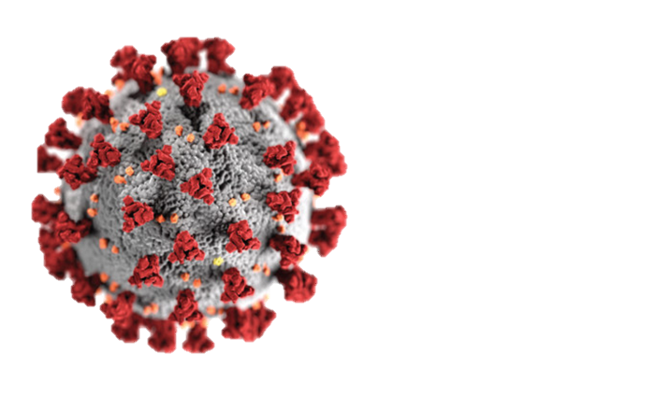
Automotive Industry & COVID19 Impact
Group 3: Dakota, Steven, Maryam, Joyce

Slide 2
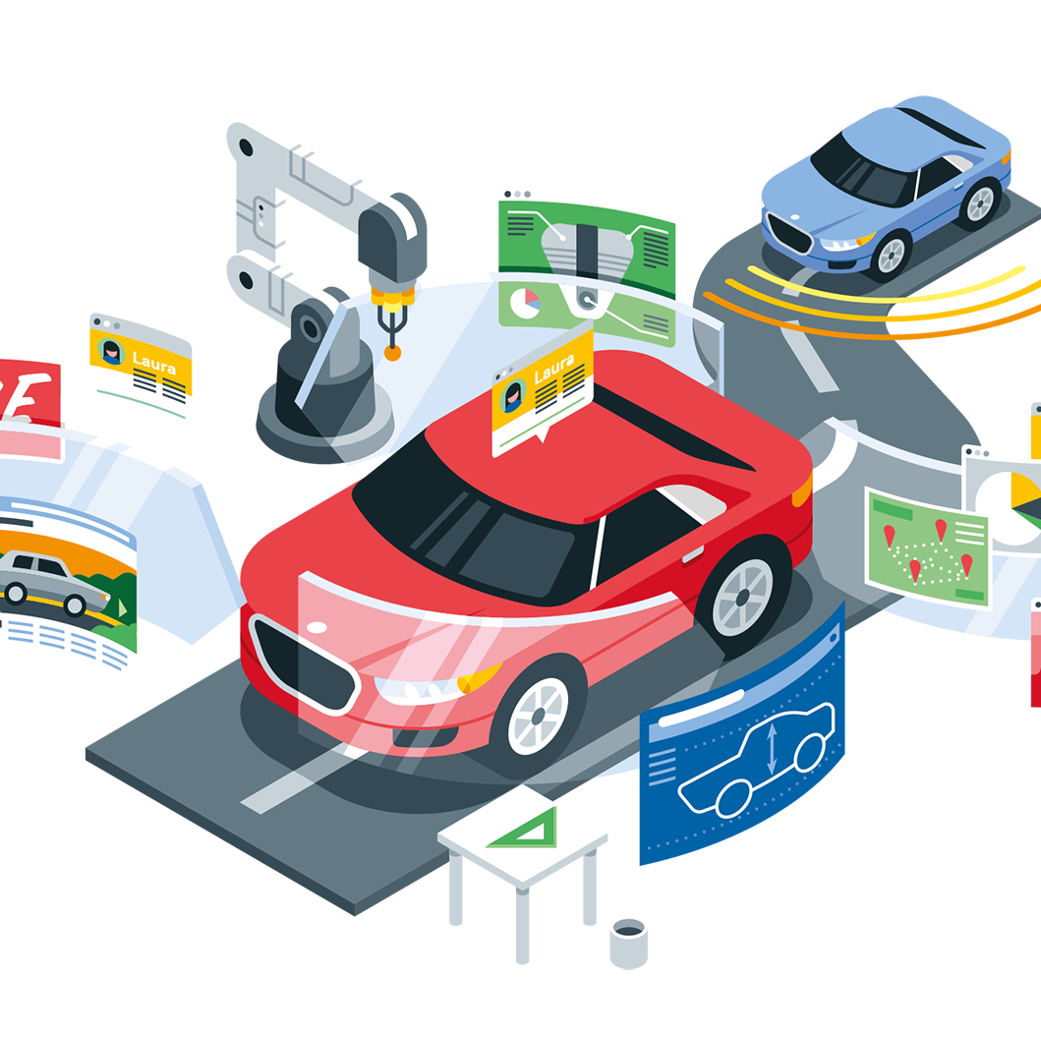

Goal
We are trying to evaluate the impact COVID 19 had on the automotive sales industry, and uncover sales trends that would lead to maximum profitability for current dealerships in the future.
Notes:
Based on the gathered data and our analysis, we are
Dakota

Slide 3

Questions for Analysis:
What effect did COVID-19 have on consumer habits and behaviors in relation to car buying: brand of car, preferred mode of transport, etc?
What current car sales trends can point to the ideal inventory?
Did COVID have an equal effect on car sales based on location at a state level?
What are other potential factors affecting current car prices?
Notes:
Dakota

Slide 4
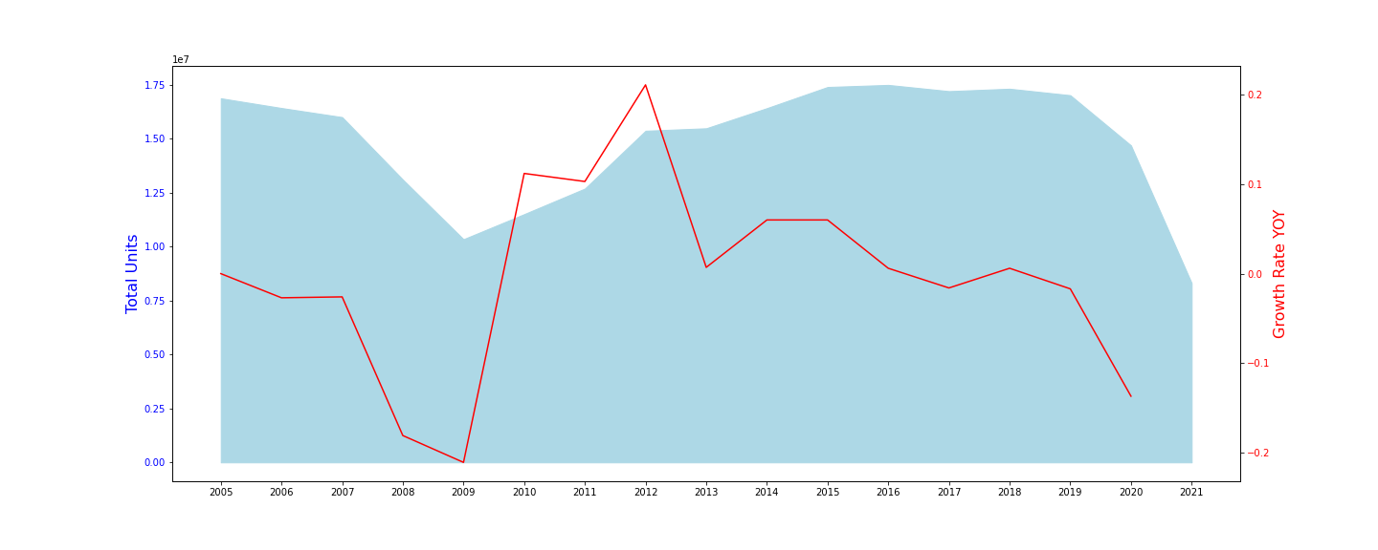
U.S. Automotive Sales
COVID-19 Impact
The financial crisis of 2007–2008
Notes:
The rest of the early to mid 2000s saw a period of relatively flat sales (some years were slightly up, some were slightly down) till 2006 when things slowed down again meaningfully. Sales had already started to cool in 2006 and 2007 (declines of -2.27% and 3.45% respectively) when the mother of all financial crisis’ really devastated the industry in terms of new car sales. 2008 saw a decline in new vehicle sales of 18% followed by 2009 which saw sales decline a further 21%.
Joyce

Slide 5
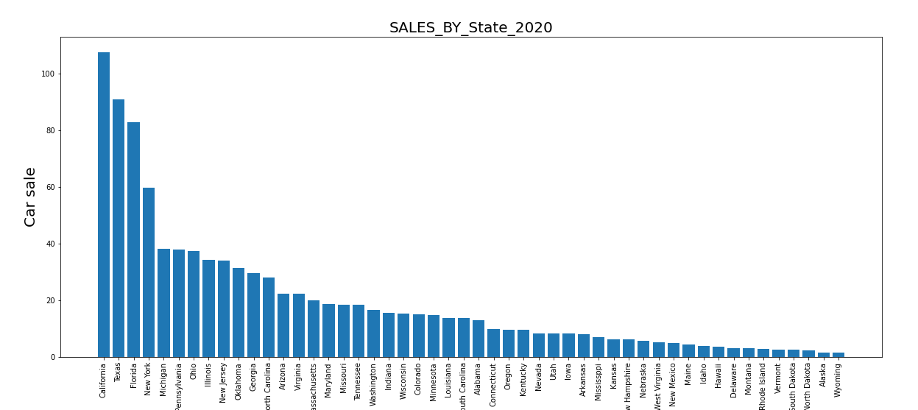
U.S. Automotive Sales by State
Notes:
The rest of the early to mid 2000s saw a period of relatively flat sales (some years were slightly up, some were slightly down) till 2006 when things slowed down again meaningfully. Sales had already started to cool in 2006 and 2007 (declines of -2.27% and 3.45% respectively) when the mother of all financial crisis’ really devastated the industry in terms of new car sales. 2008 saw a decline in new vehicle sales of 18% followed by 2009 which saw sales decline a further 21%.
Joyce

Slide 6
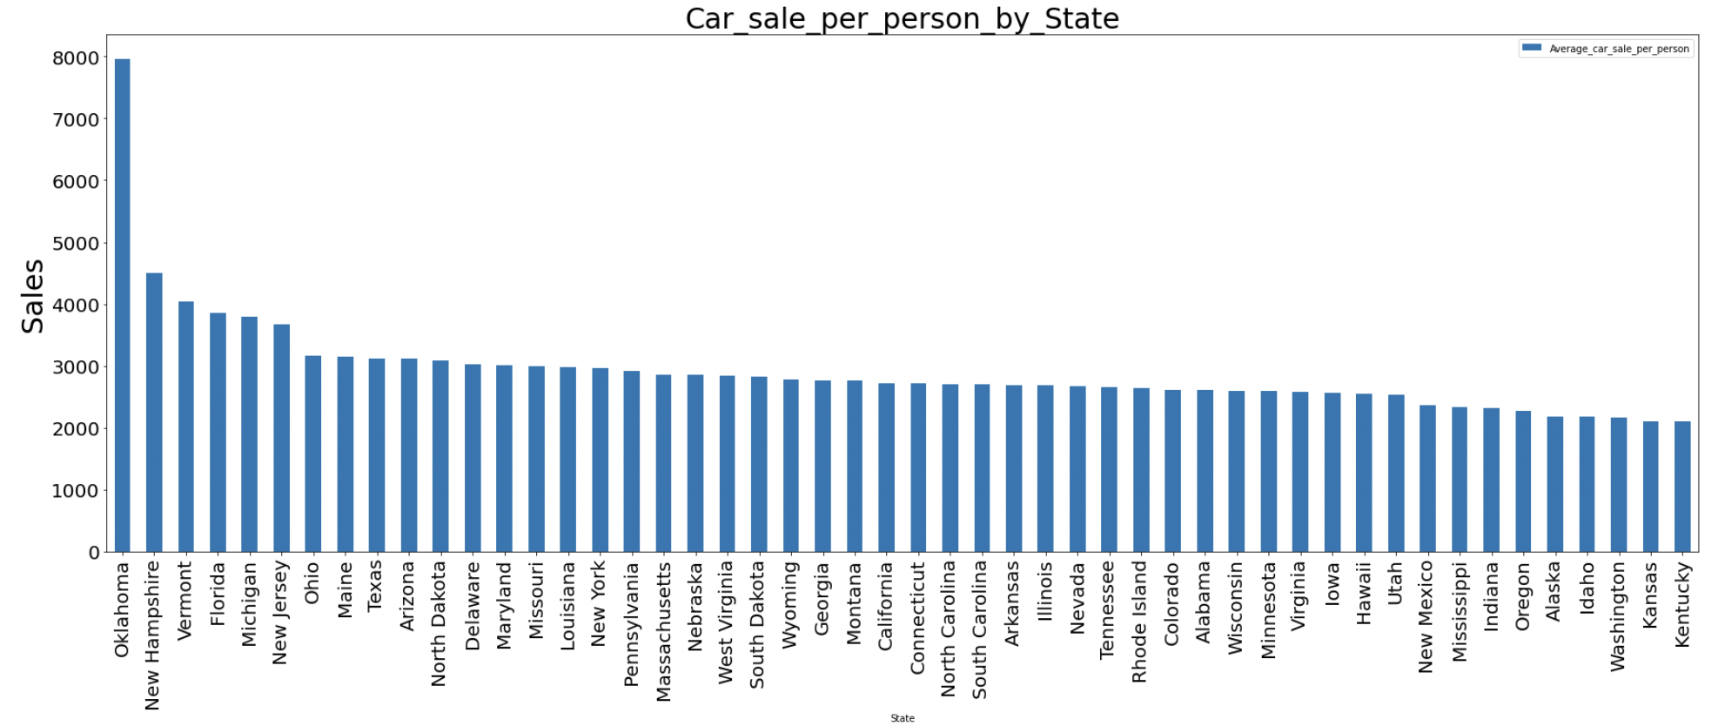
U.S. Automotive Sales per Person
Notes:
The rest of the early to mid 2000s saw a period of relatively flat sales (some years were slightly up, some were slightly down) till 2006 when things slowed down again meaningfully. Sales had already started to cool in 2006 and 2007 (declines of -2.27% and 3.45% respectively) when the mother of all financial crisis’ really devastated the industry in terms of new car sales. 2008 saw a decline in new vehicle sales of 18% followed by 2009 which saw sales decline a further 21%.
Joyce

Slide 7
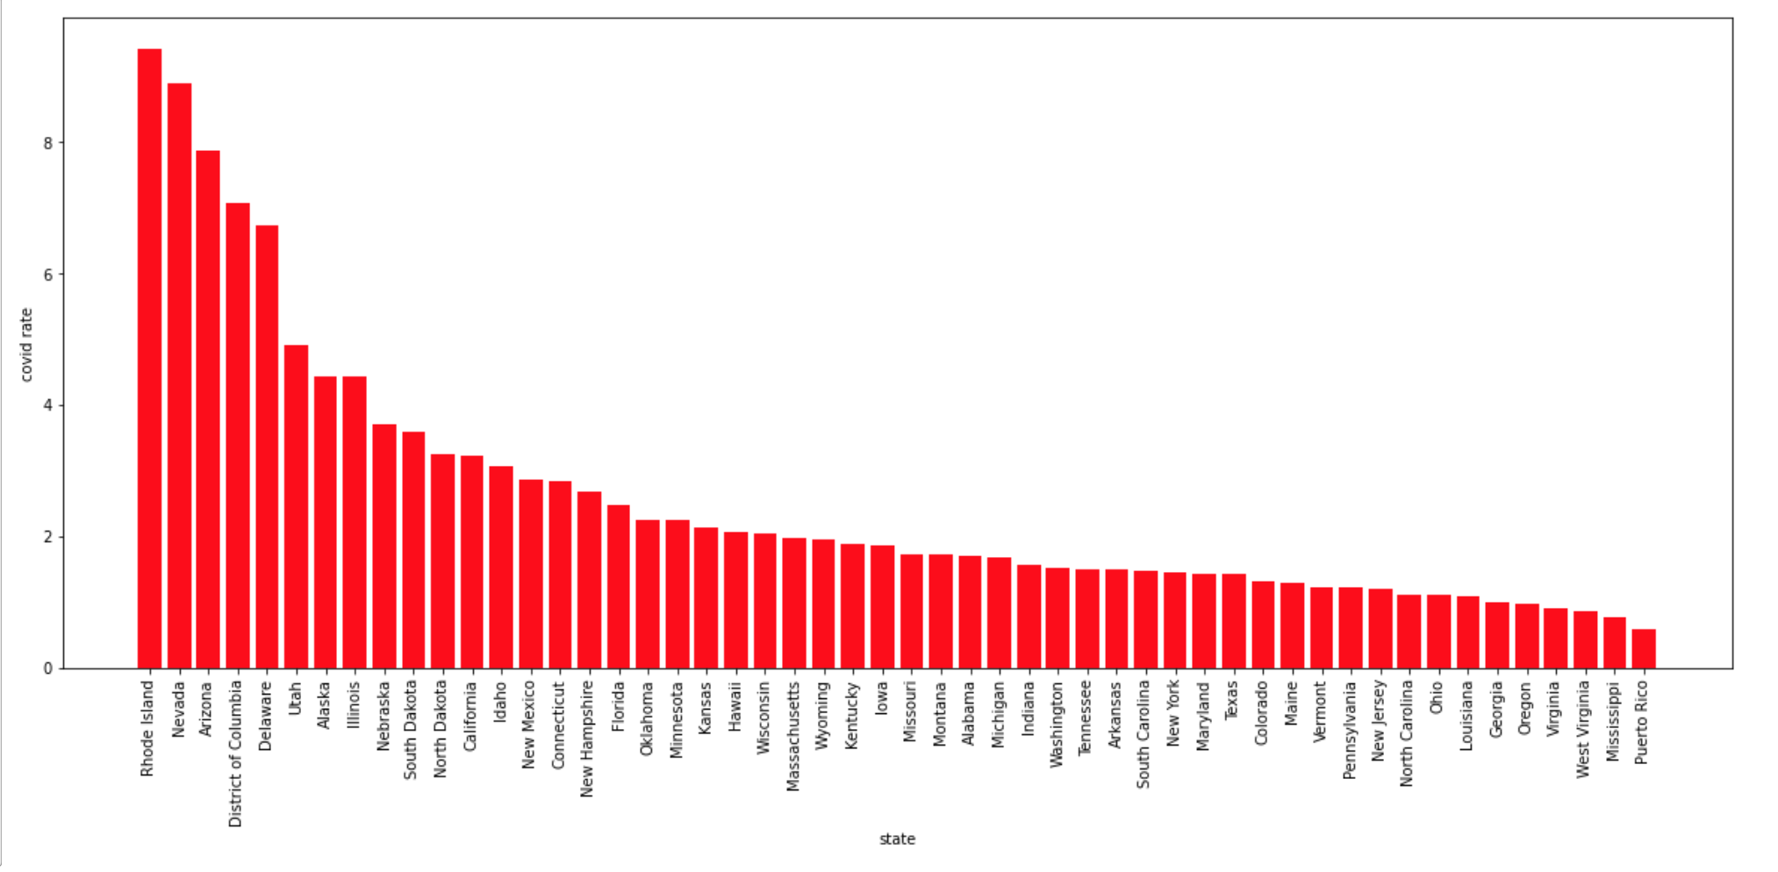
States Rank by Higher Infection Rate in 2020
Top 5 state of Automotive Sales
Notes:
Maryam

Slide 8
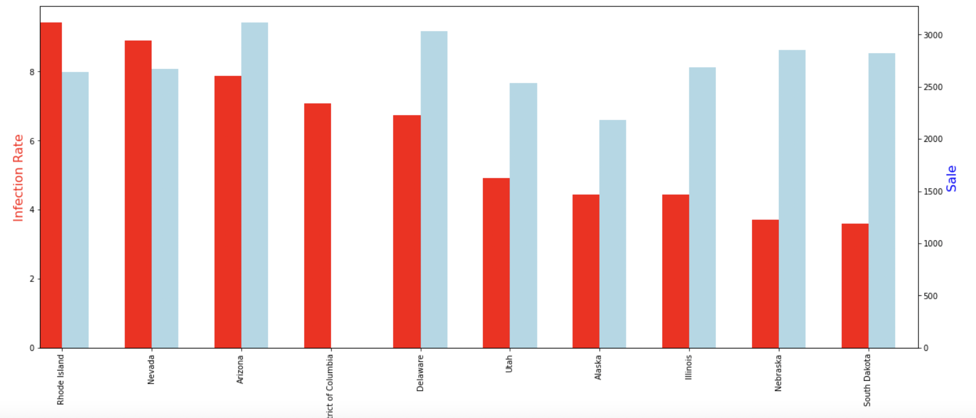
States Rank by Higher Infection Rate
Notes:
The rest of the early to mid 2000s saw a period of relatively flat sales (some years were slightly up, some were slightly down) till 2006 when things slowed down again meaningfully. Sales had already started to cool in 2006 and 2007 (declines of -2.27% and 3.45% respectively) when the mother of all financial crisis’ really devastated the industry in terms of new car sales. 2008 saw a decline in new vehicle sales of 18% followed by 2009 which saw sales decline a further 21%.
Maryam

Slide 9
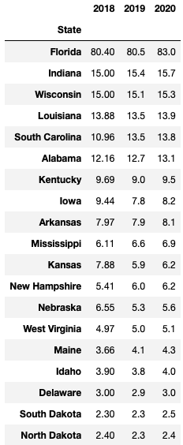

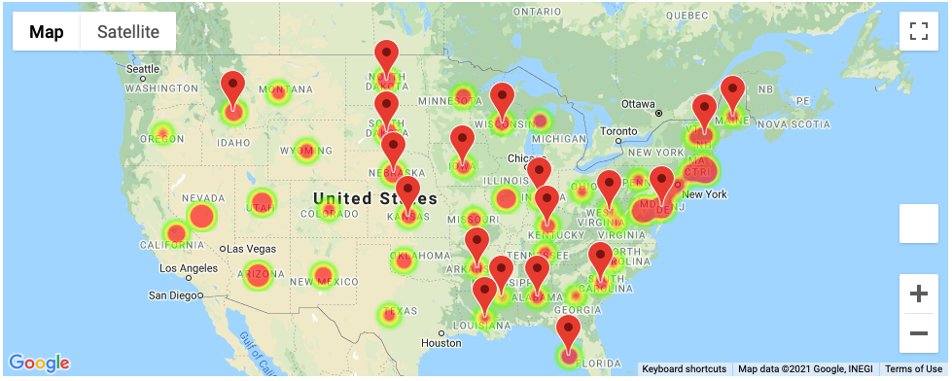
The State didn’t impact by COVID that Car Sale in 2020 higher than 2019
Sale (Unit:billion)
Notes:
Maryam

Slide 10
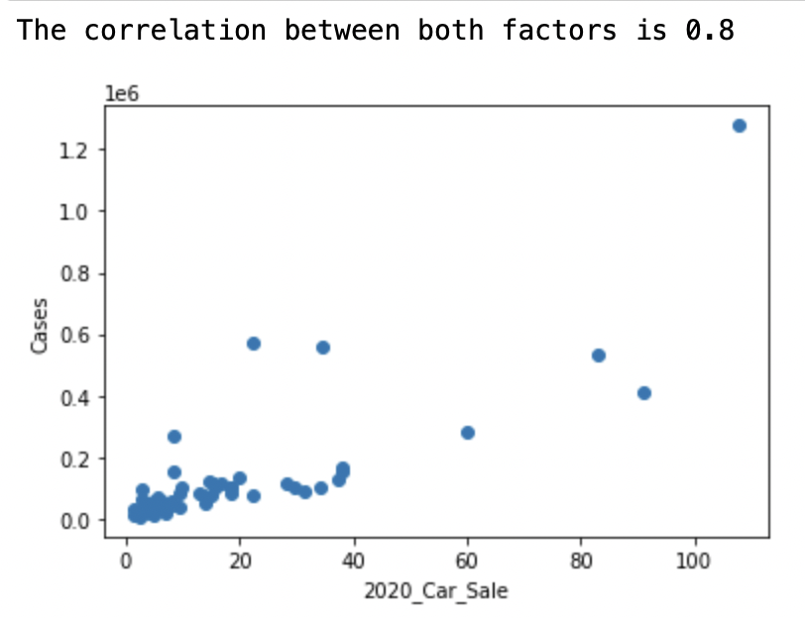


Correlation between Sale and Case is 0.8

Slide 11
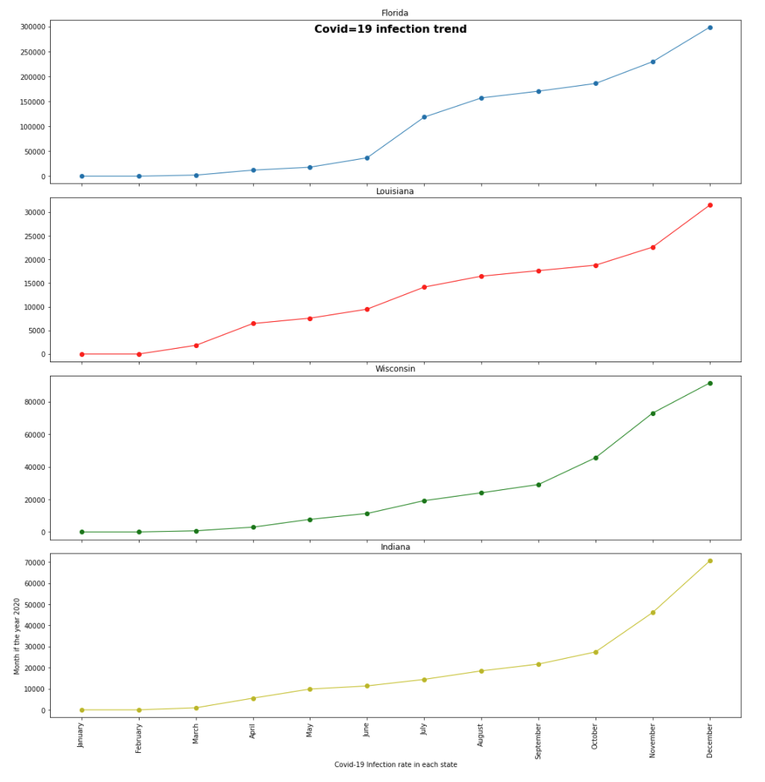


Covid-19 Infection Rate in
Unimpacted states
Notes:
Maryam

Slide 12
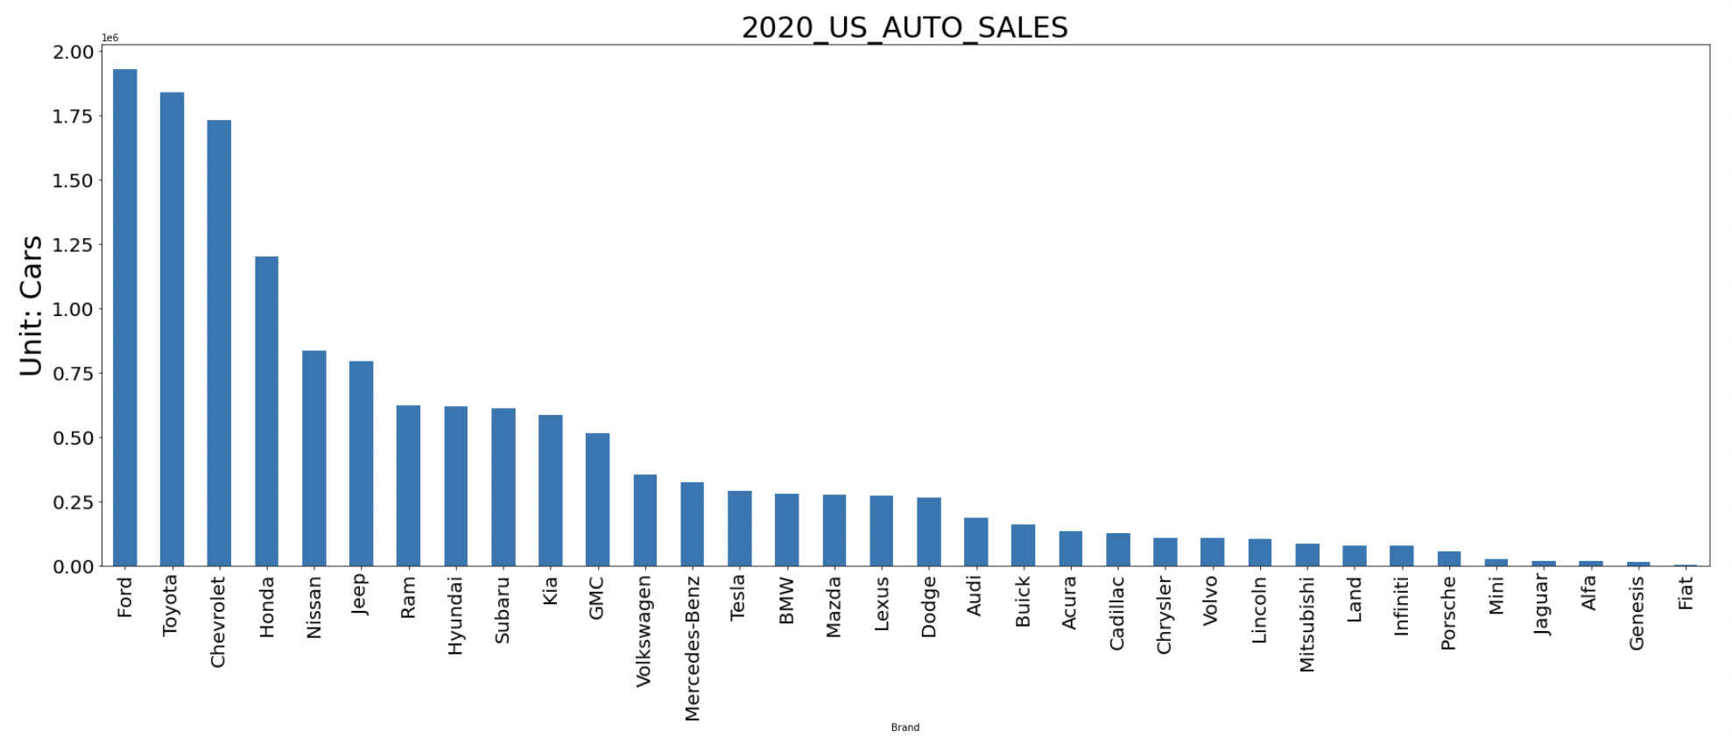
U.S. Automotive Sales by Manufacturer
Notes:
The rest of the early to mid 2000s saw a period of relatively flat sales (some years were slightly up, some were slightly down) till 2006 when things slowed down again meaningfully. Sales had already started to cool in 2006 and 2007 (declines of -2.27% and 3.45% respectively) when the mother of all financial crisis’ really devastated the industry in terms of new car sales. 2008 saw a decline in new vehicle sales of 18% followed by 2009 which saw sales decline a further 21%.
Maryam

Slide 13
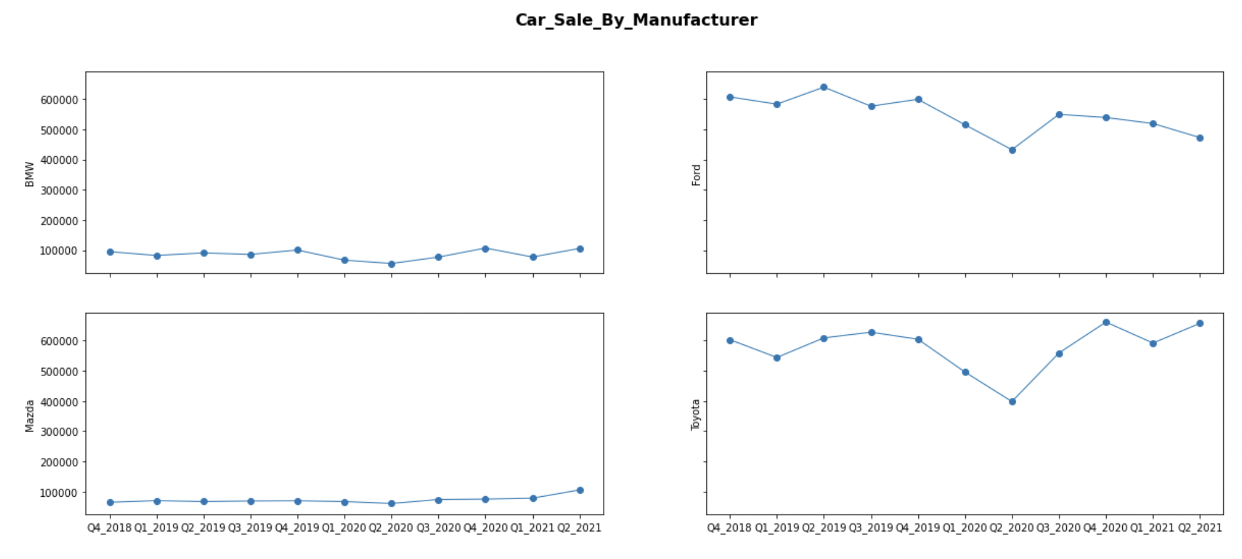
U.S. Automotive Industry
Notes:
Maryam

Slide 14
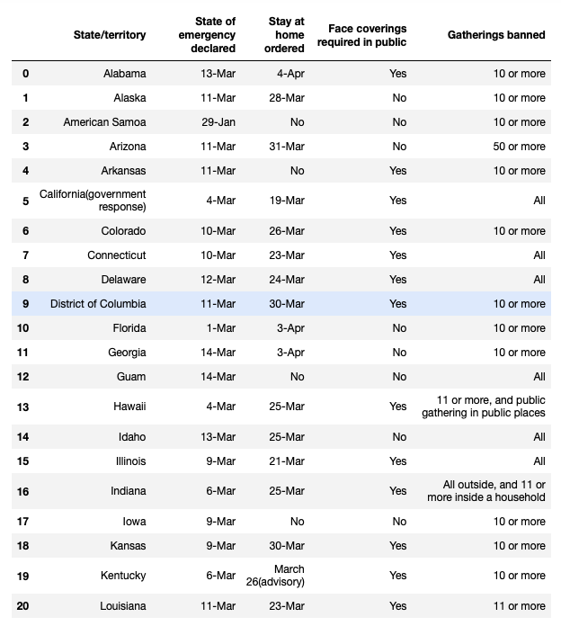
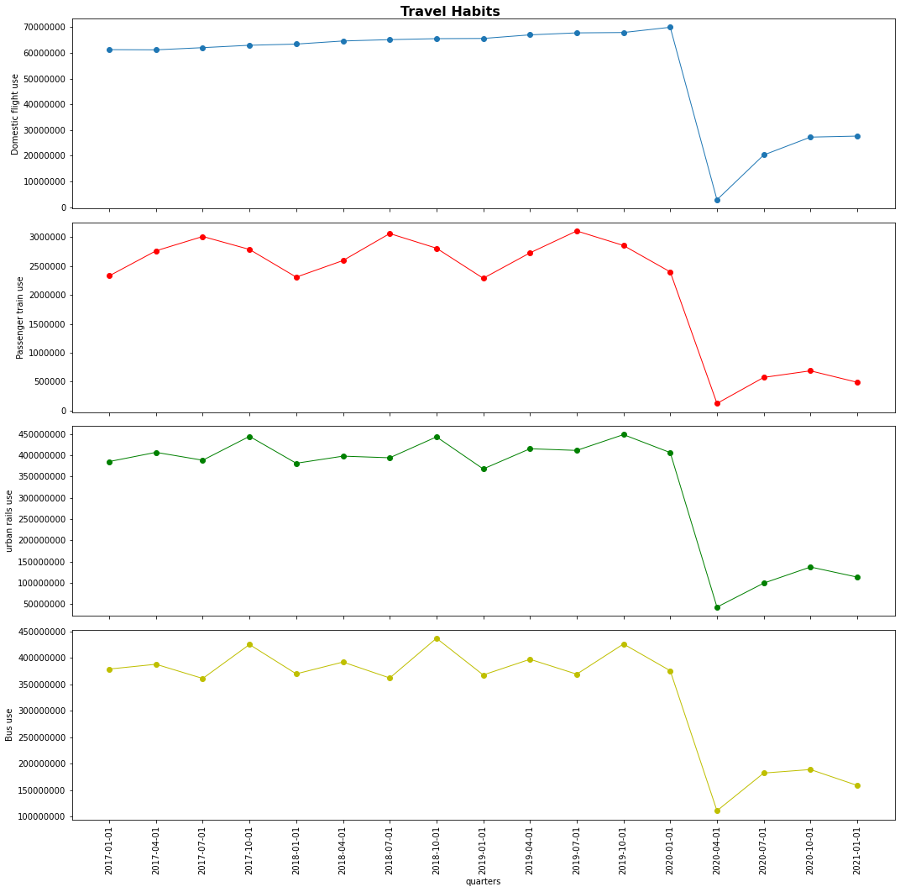
COVID Impact Travel Behaviors

Slide 15
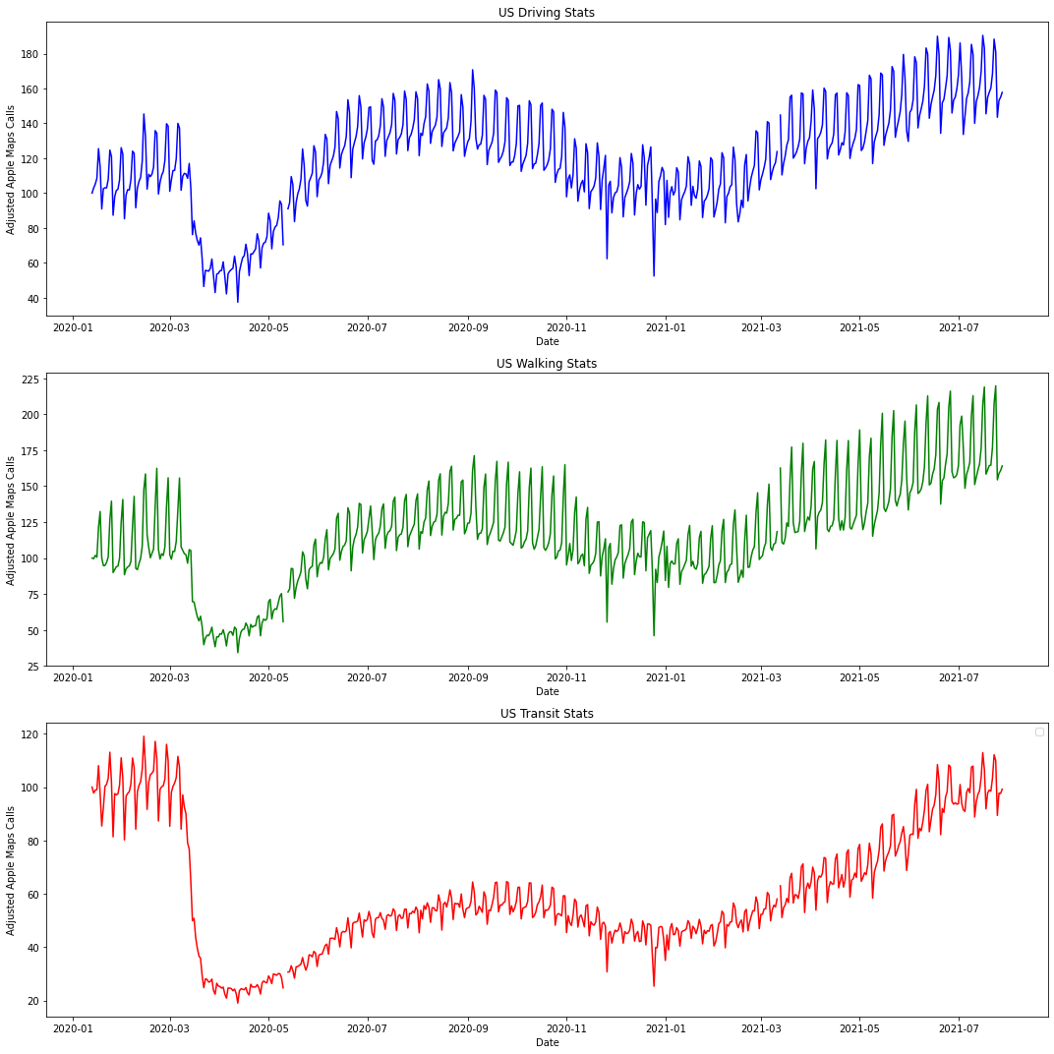

Slide 16

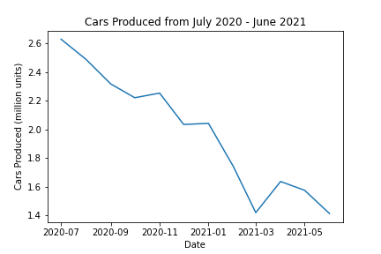
COVID Impact on Supply Chain

Slide 17
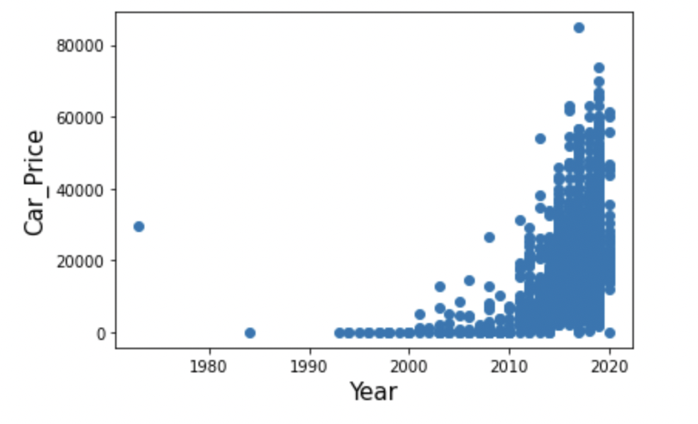
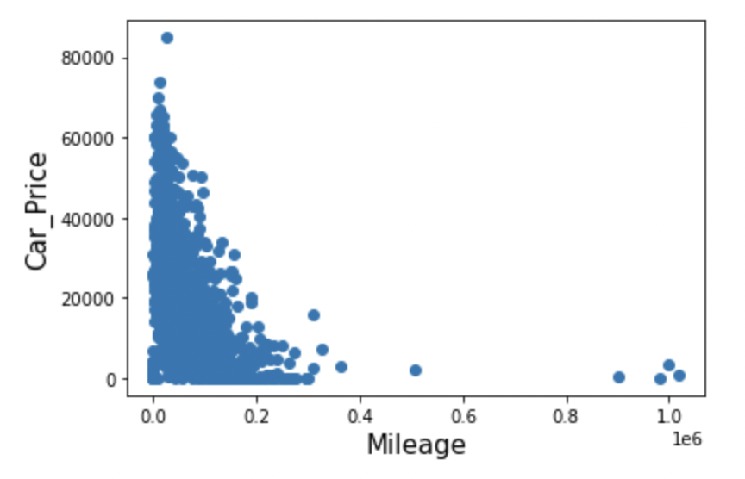
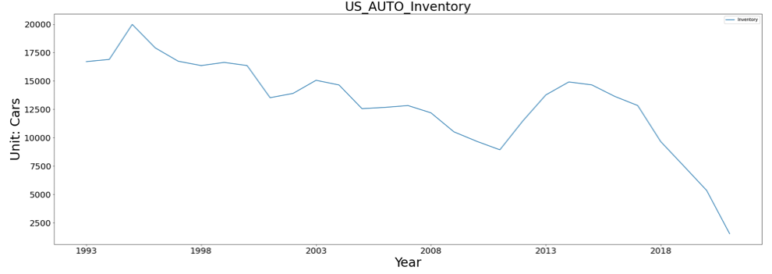
Factors Affecting Price

Slide 18
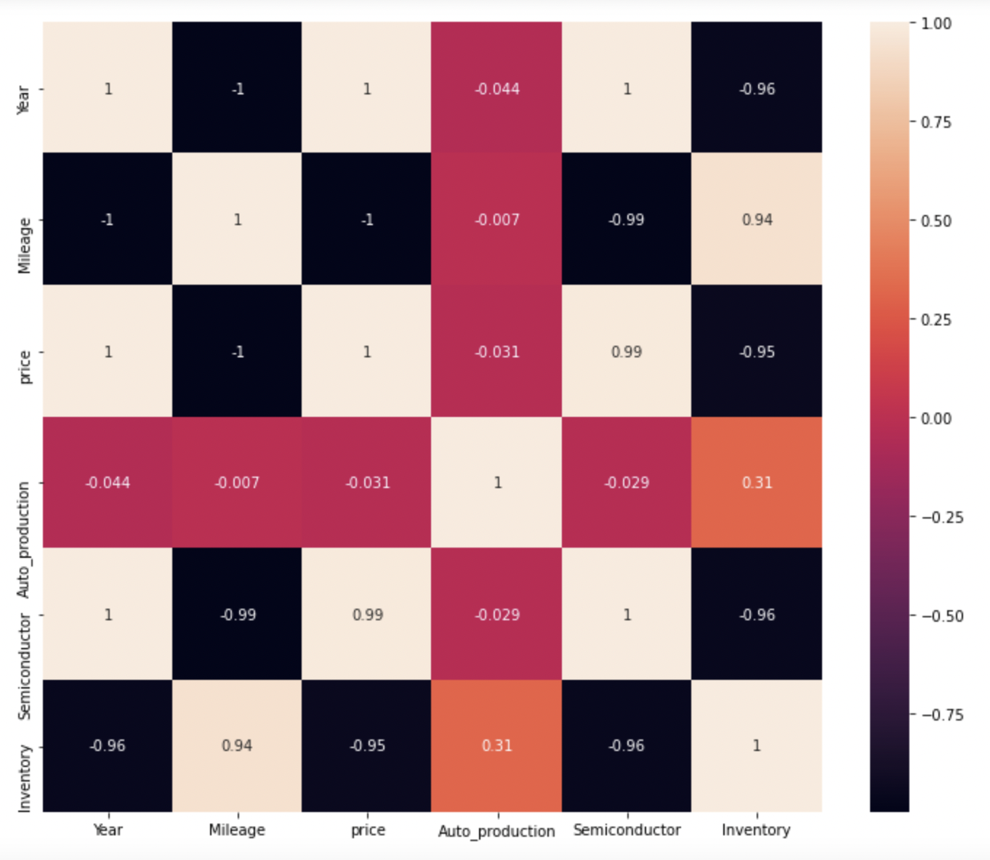

Factors Affecting Price Correlation

Slide 19

Summary
Based on our data we have concluded COVID 19 did have a direct negative impact on the auto sales industry, however we did not see enough evidence to support the idea that infection rate alone caused the decline in sales
However, there were car manufacturers and locations that were resilient during the COVID pandemic with a positive sales trend moving into this current year.
Increase in consumer demand in 2021 coupled with a car supply shortage has increased car prices
As a result we expect to see dealerships with toyota inventories to dominate both market share and be the most profitable dealerships based on current market conditions

Slide 20

Thank you

